Slide 1
NEOPLASM OF LARYNX,TRACHEA,BRONCHI
Presented by
Dr.Mahadevi A.L
Assistant Professor
Dept of Paediatrics

Slide 2
VOCAL CORD NODULES
Vocal cord nodules (referred to as “vocal fold” nodules by physicians) are growths that form on the vocal cords.
These bumps are benign (noncancerous) and are similar to calluses that can form on the hands.
Nodules affect girls and boys of any age, and are a common cause of voice issues in both children and adults.
Vocal cord nodules are also called “Singer’s nodules,” as people who use their voice regularly may inadvertently ‘abuse’ their vocal cords and cause the formation of these growths and related voice issues.

Slide 3
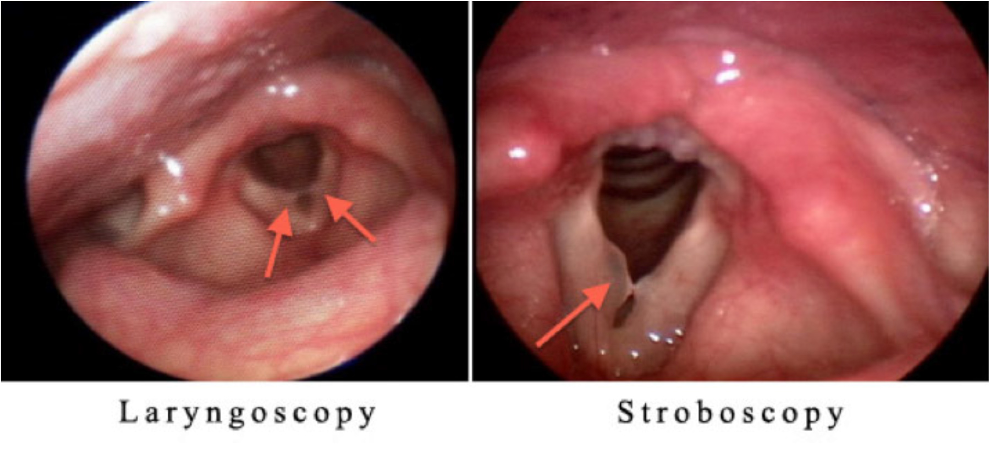

Slide 4
Signs and symptoms
The most common symptom of vocal cord nodules is a raspy or hoarse voice. You may also hear straining and pitch breaks in your child’s voice when he talks or sings.
Cause
Vocal cord nodules usually develop due to chronic abuse of the voice over time, such as straining, yelling and frequent singing. Ongoing friction between the vocal cords creates callous-like growths.
Gastroesophageal reflux disease (GERD) can cause additional swelling and inflammation, worsening symptoms of vocal cord nodules.

Slide 5
Testing and diagnosis
Vocal cord nodules can be diagnosed using the following procedures:
Laryngoscopy: A doctor will place a spaghetti-like camera in your child’s nose and down the throat. This allows our team to look at your child’s voice box, or larynx.
Stroboscopy: A small, thin, flexible endoscope with a camera is gently inserted through the nose to the area in the back of the throat above the vocal cords. The study evaluates the motion and vibration of your child’s vocal cords when there are concerns regarding the strength, pitch and quality of his voice.

Slide 6
Treatment
The recommended treatment of vocal cord nodules includes learning to properly use the voice (also known as practicing vocal hygiene) and voice therapy. Practicing good vocal hygiene includes:
Avoiding yelling/screaming
Learning to properly imitate when pretend-playing
Drinking plenty of water
Maintaining a healthy diet
Managing symptoms of reflux and allergies: Many times, the swelling of the vocal folds that lead to nodules are triggered by regurgitation, so reflux management may be recommended
At CHOP’s Pediatric Voice Program, voice therapy is performed by a speech pathologist who is trained in voice therapy for children.

Slide 7
Outlook
The prognosis for children and adolescents with vocal cord nodules is good. With proper vocal hygiene, reflux management when needed, and voice therapy, a majority of patients have a significant improvement in the voice and many have resolution of the voice problems.
Children with persistent nodules and symptoms of voice problems may require more aggressive therapy if the impact on the voice is severe. Children are not likely to need surgery to treat nodules, though professional voice users (i.e. singers and actors) do sometimes need surgery to remove vocal cord nodules if it affects their livelihood.

Slide 8
RECURRENT RESPIRATORY PAPILLOMATOSIS
Recurrent respiratory papillomatosis is a disease marked by recurrent multiple growths of benign tumors, or papillomas, in the respiratory tract. The wart-like growths can be found in the nose, pharynx (throat), larynx (voice box), trachea (windpipe), esophagus (swallowing tube) and rarely in the lungs.
Synonyms of Recurrent Respiratory Papillomatosis
juvenile-onset laryngeal papillomatosis
laryngeal papillomatosis

Slide 9
Subdivisions of Recurrent Respiratory Papillomatosis
adult onset recurrent respiratory papillomatosis (AORRP)
juvenile onset recurrent respiratory papillomatosis (JORRP)
RRP is generally broken down into two subtypes – the juvenile-onset form and the adult-onset form.
Juvenile cases develop before the age of 12 and are generally more aggressive and recurring.
Children tend to need surgical treatment more often than adults.
The disorder tends to improve in late childhood.
Although aggressive disease is more common in children, adults can still potentially develop an aggressive form of the disorder.

Slide 10
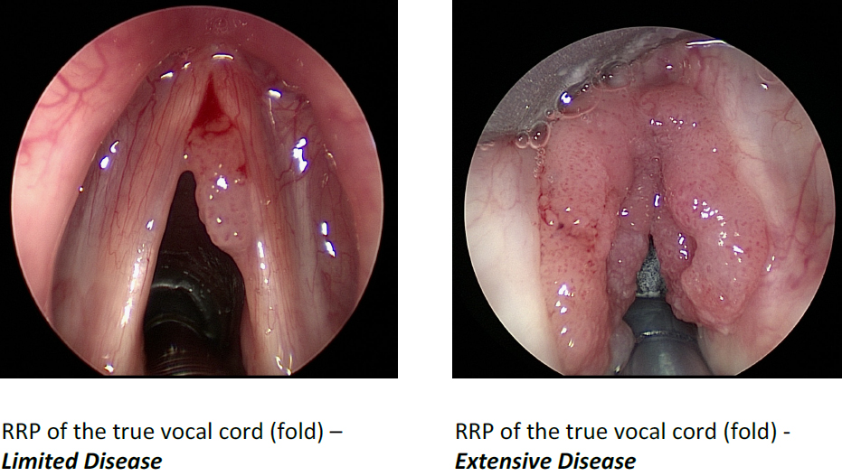

Slide 11
Causes
Recurrent respiratory papillomatosis is caused by the human papillomavirus (HPV).
This virus is common in human beings with some studies estimating that as many as 75%-80% of men and women will be affected by HPV at some point during their lives if they are not vaccinated against the virus.
HPV is passed through genital contact, most often during sex.
Most individuals who are infected with HPV never develop any symptom

Slide 12
In children, the most likely cause of the transmission of HPV is passage from an affected mother to the child during labor as the child passes through the birth canal.
However, this may not account for all cases of juvenile onset RPP and other mechanisms for HPV infection may exist. Some cases appear to have developed before birth (in utero).
Most children born to women with HPV do not develop RRP.
In addition, many individuals with HPV in the tissues of the respiratory tract never develop papillomas.
This suggests that additional factors, such as immunologic or genetic ones, are necessary for the development of RRP in individuals with HPV.
Other factors such as timing, length and volume of exposure to the HPV may play a role

Slide 13
Signs & Symptoms
The specific symptoms, course of the disease, and severity of RRP can vary greatly from one person to another.
In some cases, the disease may resolve without treatment (spontaneous remissions) or it may remain stable requiring only periodic intervention (e.g. only a few surgeries during their lifetime).
In other cases, the disease may be aggressive requiring frequent medical intervention and potentially more than 100 surgeries during a person’s lifetime.

Slide 14
Hoarseness may become progressively worse and the voice of an affected individual may be weak, raspy or sound low in pitch or strained.
The severity of voice problems can vary from one person to another due, in part, to the size and specific locations of papillomas.
Affected individuals may develop labored, noisy breathing (stridor) due to obstruction of the airway.
Initially, stridor may occur when breathing in (inspiratory stridor), but eventually occurs both when breathing in and out (biphasic stridor).
Some individuals may exhibit difficulty speaking (dysphonia) or lose their voice entirely (aphonia).
Affected infants may also have a weak cry, episodes of choking and fail to grow and gain weight at the expected rate (failure to thrive).

Slide 15
Additional symptoms that can develop include
a chronic cough,
difficulty swallowing (dysphagia),
shortness of breath or difficulty breathing (dyspnea),
the sensation of a foreign body in the throat,
and choking episodes.
Left untreated, papillomas can eventually compromise the airways, resulting in life-threatening breathing difficulties (acute respiratory distress).
If RRP spreads to the lungs,
affected individuals can potentially experience recurrent pneumonia, chronic lung disease (bronchiectasis) and, ultimately, progressive pulmonary failure.
In extremely rare cases (i.e. less than 1% of cases), papillomas can become cancerous (malignant transformation) developing into squamous cell carcinoma.

Slide 16
Risk factors of RRP.
increased risk of disease or infection.
Three risk factors for juvenile-onset recurrent respiratory papillomatosis are
being a firstborn child,
having a vaginal delivery with a prolonged labor,
and the mother being under 20 years of age.
If the mother has active genital warts, the risk of passing on HPV is approximately 1 in 250-400.
These risk factors do not apply to adult-onset recurrent respiratory papillomatosis.
Adult-onset recurrent respiratory papillomatosis may be worsened by tobacco exposure, gastroesophageal reflux, or radiation therapy.

Slide 17
The juvenile form of recurrent respiratory papillomatosis affects males and females in equal numbers.
The adult form affects males slightly more often than females.
In the United States, the incidence of RRP was previously estimated to be approximately 2 per 100,000 adults and 4 per 100,000 children with approximately 1,000 new pediatric cases in the United States each year.
With the increased uptake of the HPV vaccine, these numbers are dropping precipitously.
In children, JORRP is most often diagnosed between the ages of 2-4.
In adults, the disorder occurs most often in the third or fourth decade though a second peak around age 60 has recently been noted.

Slide 18
Diagnosis
Physical exam
Laryngoscopy and bronchoscopy — examination of the throat, larynx, vocal cords and the bronchi with a scope

Slide 19
Differential diagnosis.
asthma, allergies, chronic bronchitis, croup, vocal nodules, and gastroesophageal reflux.
Treatment is directed toward
removing papillomas,
decreasing the spread of disease,
creating a safe and patent airway,
preserving nearby anatomical structures,
improving voice quality if necessary and increasing the time between surgical procedures

Slide 20
Specific therapeutic procedures and interventions may vary, depending upon numerous factors, such as
frequency of disease recurrences;
specific location and spread of the disease;
papilloma size;
the presence or absence of certain symptoms;
an individual’s age and general health;
and/or other elements.

Slide 21
Treatment
The goal of the treatment is to clear the airway of growths and to prevent or reduce the occurrence of new ones.
Surgery to remove the growths
Antiviral medications to try to suppress the replication of the virus

Slide 22
CONGENITAL SUBGLOTTIC HAEMANGIOMA
Subglottic hemangiomas may form a large mass in the airway below the vocal cords, causing varying degrees of airway obstruction.
They grow rapidly for at least 12 to 18 months followed by slow shrinking.
Some hemangiomas require medical intervention because of their life-threatening nature in the airway.
Hemangiomas are the most common vascular malformation in infants and children. The malformation is composed of capillaries and other small vessels.
They may occur anywhere on the body and most appear as solitary skin lesions without involvement if the airway.

Slide 23
Signs and symptoms
Hemangiomas of the larynx or trachea are often seen in children who have multiple hemangiomas appearing in a particular dermatomal region (one of the four regions of the body associated with a particular spinal nerve).
They may be associated with hemangiomas in other non-airway sites such as the skin of the scalp or back.
Symptoms include:
Croup-like cough
Noisy breathing when inhaling and exhaling
Difficulty breathing

Slide 24
Testing and diagnosis
Endoscopic view of bilateral subglottic hemangiomas.To diagnosis a subglottic hemangioma, the child will first have a plain neck X-ray.
The X-ray alone may show a mass in his airway.
Flexible laryngoscopy in the office may also be enough to reveal that a hemangioma is causing the respiratory symptoms.
To confirm the diagnosis, the doctor will perform an endoscopy with microlaryngoscopy and bronchoscopy. This will help to determine the extent of the airway hemangioma and make sure that it has no extension into the tracheal airway.
Once the airway is established, an MRI of the neck and brain is useful to ensure that the hemangioma has not extended into the neck or skull.

Slide 25
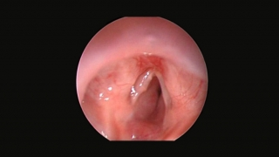

Slide 26
Treatment
There are many potential treatments for subglottic hemangiomas which will depend on the severity of the child's case. A drug called propanolol is rapidly becoming the first line treatment for severe subglottic hemangiomas
Subglottic hemangiomas can be treated using steroids, tracheostomy, laser, intralesional steroid injections, microdebrider excision, and open surgical excision. These all come with some risk.
Lasers and microdebridement of the subglottic hemangioma carries the risk of scarring which may lead to subglottic stenosis.
Steroids may improve symptoms but put the child at risk of many side effects. Steroid use is only advised for short periods of time.
Open surgery is a very effective treatment, but is a major operation with some risks. It is usually reserved for cases that fail more conservative approaches.
Tracheostomy may be used to bypass the airway until the hemangioma shrinks, but comes with risk of mucous plugging, accidental dislodgement and other life-threatening risks. Furthermore, many hemangiomas may not shrink on their own, requiring further treatment.

